Slide 1
Race and Politics
An Addendum to the Curse of Power
Notes:
https://www.dailywire.com/news/bubba-wallace-changes-course-in-new-statement-on-emotional-past-few-days?utm_source=Jeeng – FBI finds that the noose in Bubba Wallace’s garage was not a hate crime. NASCAR shutdown, like all other sports, and when it resumed (with no fans in the stands), the drivers were assigned garages, and the “noose” was already in the garage that Bubba was assigned. The “noose” was actually a pulley, designed to pull down the garage door. Apparently, “noose” hoaxes are pretty common in America today.
https://nypost.com/2022/04/13/suspect-frank-james-was-spewing-racist-hate-well-before-brooklyn-shooting/ -- The April 2022 NYC subway shooter was filled with racist hatreds, for whites but also for blacks who have become like those who once enslaved them (which would be becoming like whites)
Tennessee lawmakers expelled by House GOP: Reps. Pearson, Jones ousted (tennessean.com) https://www.tennessean.com/story/news/politics/2023/04/06/tennessee-expulsion-vote-democrats-justin-jones-gloria-johnson-justin-pearson/70079929007/ -- A story about two black representatives to the Tennessee House of Representatives who were expelled for breaking decorum rules of speaking on the House floor.

Slide 2
Lecture Outline
History of Race Relations in America
Political Culture and Race Today
An International Perspective on Discrimination/Racism
Race and Politics in America
The consequence of controversial Racial Statements
The race issue in the Obama presidency

Slide 3
History of Race Relations in America
US History on Race
History – To this day, we are haunted by our history of slavery, segregation, and discrimination of whites against blacks – these were egregious violations of American principles
Slavery – One person “owning property” in another goes against our founding principles of “individual liberty”
Segregation – Legal separation of races in society goes against our belief in “equality under the law”
Racism – Discrimination goes against our belief in “merit,” i.e., hire the most qualified for a job or admit the most deserving to institutions of high education—regardless of race, gender, national origin, etc.
Corrections for Past Injustices – Our country has tried to make amends for these injustices
The Civil War Amendments – 13th (ended slavery), 14th (equal protection and due process), and 15th (voting rights) Amendments were to correct for slavery
White culture rejected the principles of equal protection, due process, and voting rights for blacks for 100 years
Notes:
Other countries are also haunted by their histories. There are approximately 8 European countries that have laws against denying the “holocaust.” The “holocaust” was perpetrated by the Germans in WWII; it was a concerted effort to exterminate Jews (as well as other “undesirables”—Catholics, gypsies, homosexuals). These 8 countries who punish holocaust deniers are so sensitive to their past involvement or association with the holocaust that they will not tolerate deniers; they also know that Jews are very offended by holocaust denials, and they want to demonstrate that they are going to protect their Jewish populations, even at the expense of free speech rights and the right to conscience (i.e., theoretically in a free society, one would have the right to believe the holocaust did not happen and to speak his or her mind on the subject).
Turkey is also haunted by the Armenian “genocide” in 1915. When Turkey entered WWI, it proceeded to wipe out its minority Armenian population, which was very industrious and successful in Turkey (similar to the Jews in the various countries where they reside). Allegedly, Hitler got ideas from the genocide that he later used in the holocaust. Turkey denies that a genocide took place, but it is receiving increasing international pressure to make amends with Armenia by acknowledging that a genocide did occur, including pressure from the US.

Slide 4
History of Race Relations in America
US History on Race
Corrections for Past Injustices (continued)
Civil Rights and Voting Rights Acts (1960s) – ended segregation and discrimination in the public and private sectors (e.g., businesses prohibited from denying service to blacks); enforced voting rights for blacks
Affirmative Action – programs designed to help minorities gain access to jobs, higher education, and government contracts (for minority-owned businesses)
Present Day – Much progress has been made in race relations, but even so, blacks and whites have substantial differences on: 1) the need for government services, 2) hiring preferences (affirmative action), 3) the death penalty, 4) vote choice in presidential elections…just to name a few
Race and Politics – Today, the race issue is used in the struggle for power; it is akin to the “curse of power”
Accusations of racism is one of the most devastating labels in American politics…a politician labeled as racist (presuming the label sticks) is almost certainly finished in politics
Notes:
Civil rights have been expanded over the years to include other disadvantaged groups: women, Hispanics, the disabled, gays
Show polls on perceptions of who the police are more likely to shoot, a black person or a white person. The differences between the perceptions of blacks and whites is very large. See pollingreport.com: https://pollingreport.com/crime.htm

Slide 5
U.S. Culture and Race
The Status of American Culture on Race

Slide 6
Political Culture and Race
Political culture defines the rules of acceptable and unacceptable behavior
American culture today is hyper-sensitive to racial comments
High-profile commentators of professional sports and political figures have been forced to resign their positions because of racially sensitive or racist comments
Because of our past, our political culture must “prove” it has abandoned its discriminatory ways by punishing those who make racial/racist comments, whether the commentators are truly racist or not
Conservatives (Republicans) are more vulnerable than Liberals (Democrats) to punishment for racially sensitive comments
Liberals/Democrats supported civil rights (1960s), welfare (1930s to today), and affirmative action (1970s to today), and these policies were targeted to help blacks, and thus liberals are considered to be non-racist in behavior, even when they make racist remarks
Conservatives opposed civil rights and welfare and oppose affirmative action today, for non-racist principled reasons, but the culture considers conservatives as being on the wrong side of history
Notes:
Conservatives/Republicans tend to be more vulnerable to the charge of being racist, mainly because Conservatives/Republicans have fought against civil rights, affirmative action, and welfare, programs that are targeted to help blacks integrate into the business world, into higher education, and out of poverty. Of course, non-racist Conservatives/Republicans oppose these policies on principled grounds (states rights, reverse discrimination, creating dependency on big government, respectively), but racists would also cite these reasons, as cover for their racist intent—and it is always difficult to distinguish a racist from a non-racist.
A good contrast illustrating how conservatives/Republicans are more vulnerable are the Trent Lott (R-MS) and Harry Reid (D-NV) cases. Trent Lott was the Senate Majority Leader in 2002 when he attended a birthday party for then Senator Strom Thurmond (R-SC). In a speech honoring Thurmond’s life and career, Lott said that the country would have been better off and that we wouldn’t have all the problems we have today had Strom Thurmond been elected president in 1948. Thurmond ran as a Dixiecrat for president in 1948, and the Dixiecrat Party was an advocate of segregation (the separation of blacks and whites in society), so taken on the surface, Lott’s comments implied that he supported segregation, which has been rejected today as a racist blight on American history. Lott was actually trying to be complimentary of a dying old man (Thurmond died two months later); nevertheless, Lott’s comments were so controversial that he decided to resign as the Majority Leader of the US Senate (though he still retained his Senate seat until he retired in 2009; he just resigned his leadership position). Harry Reid (D-NV) is the Majority Leader of the US Senate (2007-present), and in a 2009 book, Game Change, the authors reported that Reid commented in early 2008 that then presidential candidate Barack Obama had a real shot at winning the presidency because he was a “light-skinned” black and that he did not speak with a “negro dialect.” On the surface, this is very racist language, but Reid meant it as a compliment to Obama, who he felt was the first black candidate for president who could actually win. Even President Obama came to Reid’s defense, saying he has always been on the “right side of history.” Reid did not resign his leadership position (the story was quickly displaced by the disastrous earthquake in Haiti in Jan. 2010). Both Lott and Reid intended their comments to be complimentary, though some argue that what Lott said was not true but what Reid said is true. The “negro dialect” part of Reid’s commentary is probably true, but the “light-skinned” part is not. James Clymer (D-SC) is dark-skinned, yet he held the 3rd highest position in the US House, just after Nancy Pelosi and Stenny Hoyer (2009-2011 timeframe). Lott was more suspect of being racist because he was a conservative, and the political culture (right or wrong) considers the conservative positions against welfare and affirmative action (and being against civil rights in the 1960s) as being on the wrong side of history.
Then Senator Biden (D-DE) (Former Vice President) also made a statement construed as racist about Barack Obama (that Obama is “clean”). At the time (2007-08), Biden was running against Obama for president, and Biden’s presidential run suffered after that, though I’m not sure the comment about Obama had anything to do with his struggling presidential campaign, and again, Biden has cover for his history of supporting civil rights. In fact, civil rights leaders (namely, Jesse Jackson) defended Biden after his statement about Obama made the news. Jackson said that he doesn’t consider Biden to be a racist. Ironically, Obama chose Biden as his running mate later in the presidential campaign.
In the 2020 presidential campaign (May 22 2020), Biden said, in an interview with Charlamagne tha God, on his show, The Breakfast Club, after Charlamagne told Biden that he had been critical of Biden and that he wanted Biden back on his show again because there were more issues that involve black people that he wanted to address with Biden, that if he (Charlamagne) was having trouble figuring out who to vote for, me (Biden) or Trump, then “you ain’t black.” Biden was clearly bothered that Charlamagne was not appreciating how much better Biden is for blacks than Trump, but also, Charlamagne was clearly not offended by the comment; he tried to clarify that his issues were only with Biden and had nothing to do with Trump. See: https://www.youtube.com/watch?v=jhcgmwj3NAc
Biden apologized the next day for being too cavalier and that he shouldn’t have been a wise guy and that he doesn’t take the black vote for granted. This controversy has blown over. Biden is more liberal and that helps protect him from comments like this.
In June 2020, Mike Gundy, the coach of the Oklahoma State University (OSU) football team was forced to apologize for wearing an OAN t-shirt on a fishing trip. OAN (One America News) is a conservative news network, even more conservative than Fox News, and some of its hosts have taken issue with the Black Lives Matter movement’s goals, viewing it as a far-left organization, as well as criticizing the shutdown of the economy in response to the coronavirus. Mike Gundy (the coach of OSU) is clearly a political conservative, but some of his star players, particularly a Heisman-candidate running back, Chubba Hubbard, have objected to the coach wearing such a shirt in the political environment that exists after George Floyd’s death. In order to not to be labeled a racist (and probably in order to keep his job and certainly to maintain the peace with some of his black players), Gundy has had to renounce some of his conservative views. Conservatives are more suspect of being racist than liberals, and this is another example of that political reality in America.
Geraldine Ferraro was a Democrat who was forced out of her position as fundraiser for Hillary Clinton’s presidential campaign (2008) for a comment she made about Obama. Ferraro was the Democratic Vice Presidential candidate in 1984; that’s her claim to fame, and in 2008, she was a Hillary Clinton supporter; during the Democratic primaries, she commented that people were voting for Barack Obama because they were enamored with the concept of voting for a “black man for president.” This comment became very controversial and she was forced to resign as a campaign fundraiser for Hillary Clinton. Ferraro’s history of supporting civil rights, welfare and affirmative action did not save her. In a strange way, Hillary Clinton was treated like a Republican while running for president against Barack Obama in the Democratic primaries, and as a consequence, Geraldine Ferraro was treated like a Republican (and considered a racist).
Jimmy “the Greek”, Howard Cossell, Al Campanis, Rush Limbaugh, Don Imus, and Don Sterling have each lost jobs for making racially sensitive or racist comments about sports figures.

Slide 7
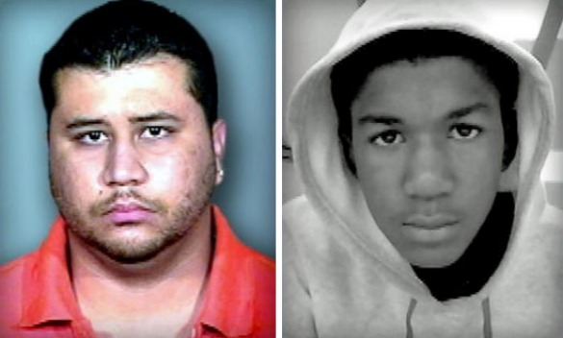
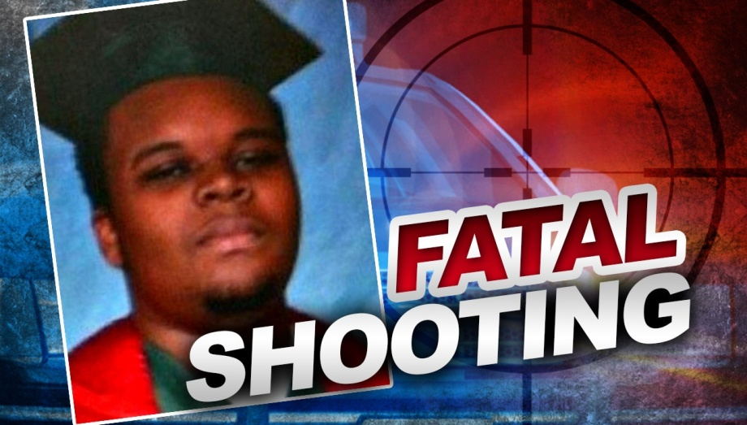
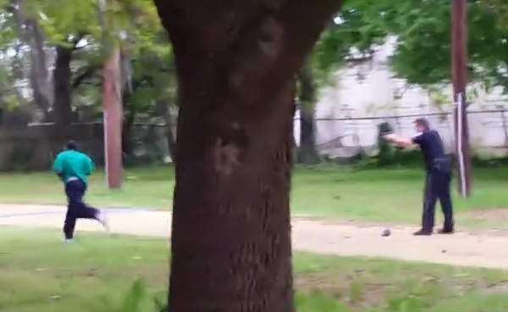
Race in America Today Some Setbacks in Race Relations
Since 2012, a number of black men have been shot by police (or community watchmen), and some of the shooters were not prosecuted (Darren Wilson & Daniel Pantaleo were acquitted by Grand Juries)
This has reinforced the perception that our culture tolerates police brutality (and murder) of blacks
As a backlash, ~15 police officers have been shot (at least 10 killed) in the wake of the police shootings of these and other black men
Notes:
On the slide is George Zimmerman and Trayvon Martin, Michael Brown, and Walter Scott (running from the police officer). Zimmerman shot and killed Martin in Feb. 2012. Michael Brown was shot and killed in Aug. 2014. Walter Scott was shot to death in Apr. 2015.
As of June 2015, Michael Slager was indicted by a grand jury for murder. Slager killed Walter Scott, after Scott fled from his car after being pulled over by Slager. Slager ran down Scott and tried to shoot him with is taser, but the two struggled for the taser, and the taser was thrown to the ground in the struggle. Slager then pulled his gun and shot Scott in the back as Scott ran away. The state court resulted in a hung jury, but Slager was also charged in federal court for civil rights violations, and in 2017, he was sentenced to 20 years in prison.
Eric Garner is not shown in the graphics. He was killed by NYC Officer Daniel Pantaleo in July 2014 after being arrested for illegally selling cigarettes. Garner was suffocated to death. The grand jury found that the pressure Pantaleo placed on Garner’s body as he held him down face-down on the ground was not the only contributing factor in Garner’s death. Garner had asthma and was grossly overweight, and since these factors also contributed to his death, the grand jury did not indict Pantaleo for murder.
Tamir Rice, a 12-year old, was shot and killed by police in Cleveland, OH in Nov. 2014. Tamir was waving a toy gun at people on a playground. The person who called in the incident told the dispatcher that the gun may not be a real gun, but the dispatcher apparently failed to pass that information to the officers who took the call.
In July 2015, Samuel Dubose was shot in the head and killed by a campus police officer (Raymond Tensing) at the University of Cincinnati. The police officer was white, and Dubose was black. Dubose was pulled over for not displaying a front license plate and then he was cagey about whether he had a driver’s license. Dubose asked the police officer to look up his driver’s license number in the police database, but the officer wanted him to show an actual license. Dubose then decided to flee by speeding away in his car, but before he could get anywhere, Tensing shot him in the head. The officer was charged with murder. The first trial ended in a mistrial and the second ended in a hung jury. Eventually, the murder charge against Tensing was dropped.
Tensing claimed that he was dragged by the car and was forced to shoot to save his own life. The video of the incident does not seem to support the Raymond Tensing’s story. Watch the video here: https://www.youtube.com/watch?v=B93X9sQfYLo

Slide 8
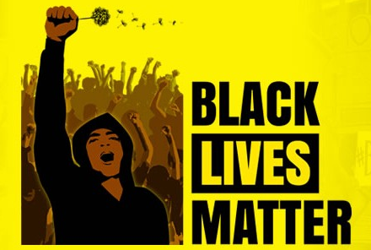
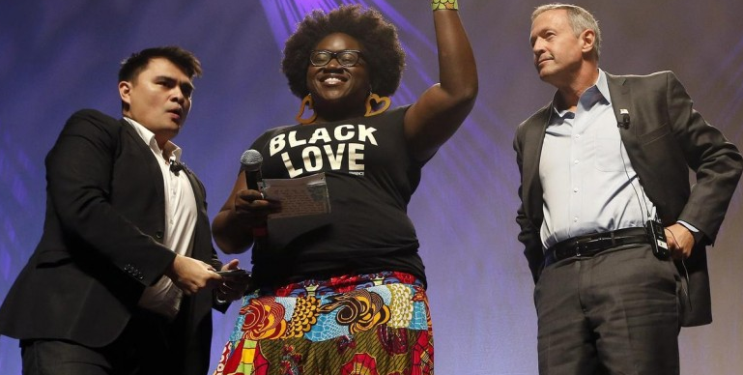
Race in America Today The Black Lives Matter (BLM) Movement
In 2015, Black Lives Matter (BLM) leaders disrupted the speeches of the Democratic presidential candidates, even taking the stage at a Bernie Sanders rally—and—shouting down Martin O’Malley when he responded by saying “all lives matter”
BLM wanted Democrats to place institutional racism (e.g., police brutality and racial targeting) against blacks and other minorities high on the Democratic presidential agenda, which did not happen in 2016, but after the police killing of George Floyd in Minneapolis (May 2020), police reform is on the agenda of both political parties
What the Critics Say: Conservative new outlets (e.g., Fox News, OAN) believe BLM has an extreme anti-policing agenda and have accused movement organizers of instigating violence against police officers
Notes:
http://blacklivesmatter.com/ -- I cut and pasted the pictures on the slide above from the Black Lives Matter website.
https://www.youtube.com/watch?v=9xNxoeqf0Ws – Fox News has shown this video of a Black Lives Matters rally in Minnesota (Aug. 2015) chanting, “Pigs in a Blanket, Fry them like Bacon.” The organizer of the rally said that the chant was more of a joke, bantering with an officer on the scene who was laughing and joking with the protesters. The organizer also said that “fry them like bacon” is meant to protest that police officers who shoot black suspects are given bail but when someone shoots a police officer, they are not given bail.

Slide 9
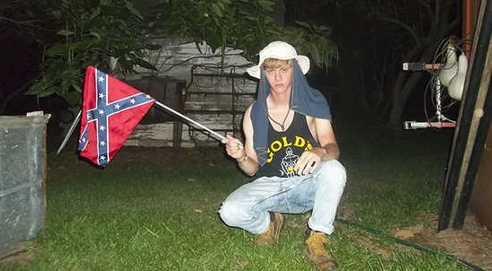
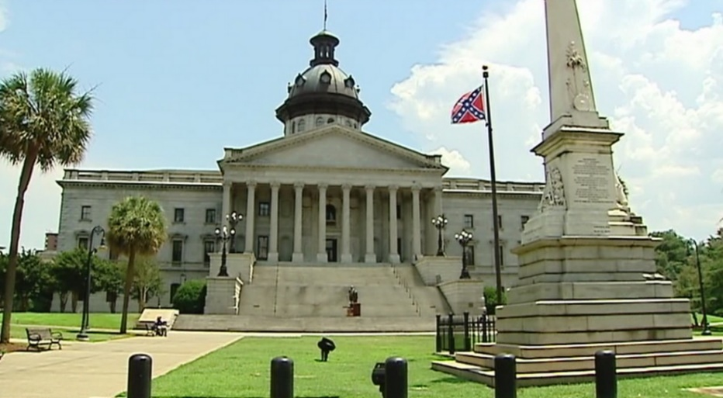
Race in America Today The Confederate Flag Controversy
In 2015, in the wake of a white supremacist (Dylan Roof) shooting of 9 black churchgoers in Charleston (South Carolina), there has been a renewed effort to take down the confederate flag at state capitols in Southern States
In the aftermath, the confederate flag on the capitol grounds of South Carolina and Alabama have been taken down
Major retailers stopped selling the confederate flag, and after the police killing of George Floyd (May 2020), NASCAR banned the confederate flag from its races
The Controversy: The confederate flag is viewed as a symbol of racism to its opponents and a symbol of Southern heritage/history to its supporters.
Notes:
In 2017, Dylan Roof was sentence to death in South Carolina, and he fired his attorneys for wanting to argue that he has autism during the sentencing phases of the trial, which apparently they thought would gain Roof sympathy. Roof is unapologetic for being racist, saying that black people kill white people everyday. He said that he would rather die than be thought of as having autism. In 2022, the U.S. Supreme Court refused to hear Roof’s case. His attorneys want the Court to stay his execution because his mental health was not fully considered during the 2016-17 trial. Dylann Roof – Wikipedia https://en.wikipedia.org/wiki/Dylann_Roof
After the racist shooting in June 2015, many retailers, including Walmart, Amazon.com, Google, Sears, eBay, have taken down the confederate flag from their websites and some have stopped selling the flag.
In October 2018, Robert Bowers entered a synagogue in Pittsburgh, PA., killing 11 Jewish worshippers. He was injured in a shootout with police, and reportedly told police on the way to the hospital that all Jews should die. Bowers is going to trial in March 2023. He faces the death penalty or 500+ years in federal prison.

Slide 10
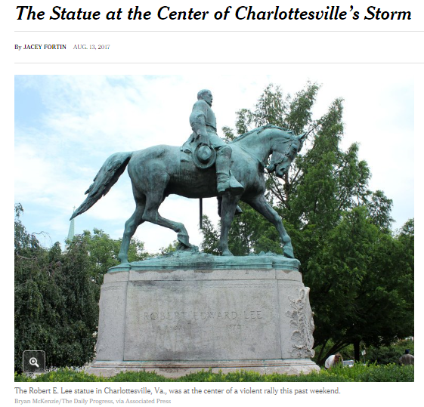
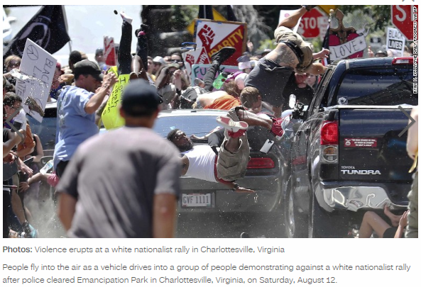
Race in America Today The Confederate Statue Controversy
In Charlottesville, Virginia (Aug. 2017), white supremacists protesting the planned removal of a confederate statue of Robert E. Lee violently clashed with those aligned against white supremacists
Since the police killing of George Floyd (May 2020), confederate statues across the country are being taken down by local governments, universities, as well as in acts of property crime by non-peaceful, violent protesters
The Controversy: Confederate statues are viewed as symbols of racism to opponents and symbols of Southern heritage/history to supporters.
Notes:
A summary of the timeline: https://www.nytimes.com/video/us/100000005363670/charlottesville-virginia-white-nationalist-protests.html.
In the wake of the Charlottesville tragedy, Trump made a statement in which he said that there were good people on both sides, i.e., that there were sincere and peaceful protesters on both sides and there were white supremacists and Antifa extremists on both sides—but some interpreted the statement as an endorsement of white supremacy, given that the image coming out of Charlottesville was that of a white supremacist marches with tiki torches and a white supremacist driving his car into a crowd of peaceful protesters, and if there were good people on both sides of these images, then Trump was assumed to have believed that some white supremacists are good people. The criticism forced Trump to clarify later that he condemns racist ideology. Some commentators speculate that Trump is reluctant to condemn white supremacists because they have vocally supported him, as president and as a candidate in the 2016 presidential campaign, and that Trump does not want to criticize his own supporters. The opposition to Trump viewed his comments condemning white supremacy as flat and lifeless, just going through the motions, and many of them view Trump as a white supremacist.
Here’s a summary of the rally at the Robert E Lee Statue: https://www.nbcnews.com/news/us-news/torch-wielding-white-supremacists-march-university-virginia-n792021
James Alex Fields Jr. sentenced: Man gets life plus 419 years in deadly Charlottesville car attack - CBS News https://www.cbsnews.com/news/james-alex-fields-jr-charlottesville-car-attack-sentenced-life-plus-419-years-today-2019-07-15/ -- Alex Fields Jr. received life in prison + time on top of that. He will die in prison, but somehow, he escaped the death penalty, despite attempting to kill as many people as he possibly could (he killed one and injured 19 by driving his car into a crowd of protesters).
On Acts of Terrorism
White supremacist killings in Charleston, SC. or in Charlottesville, VA. are by definition acts of terrorism because they are politically-inspired acts. White supremacists want a society only for white people, and they want to use government power to presumably expel all non-white, non-Christian people. This goes against our values in equality under the law for all people and against the entire principle of freedom, which is supposed to apply to all people, including white people but not just white people.
The backlash against police officers, because there have been high-profile shootings of white police officers of usually young unarmed black men, would also qualify as terrorism because those attacks on the police are politically-inspired. The viewpoint of those who turn violent against police officers is that they are racially targeting the public, and the political motivation is to use violence to change that “policy” of the police. Violence against the police is not the way we are supposed to fight for change in a democracy. The way it is supposed to work is how it is working in most cases, i.e., people peaceably protest the police when the police shoot an unarmed black man and then others lobby legislatures and Congress for change in the criminal justice system and for more funding for body cameras for police officers, and the like.

Slide 11
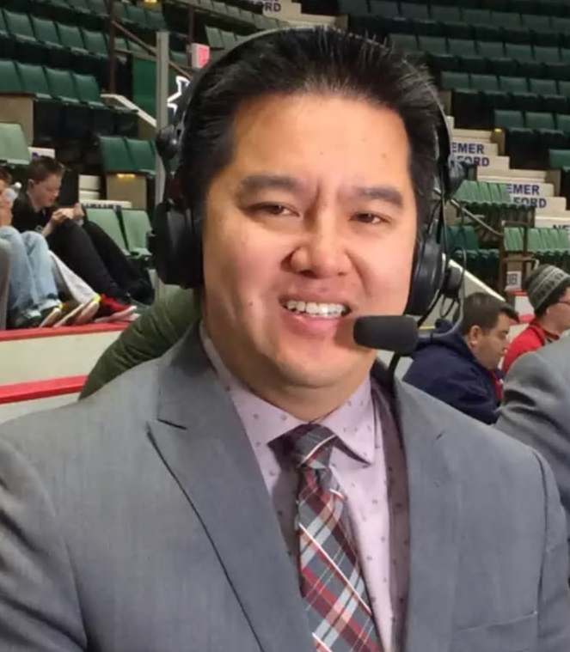
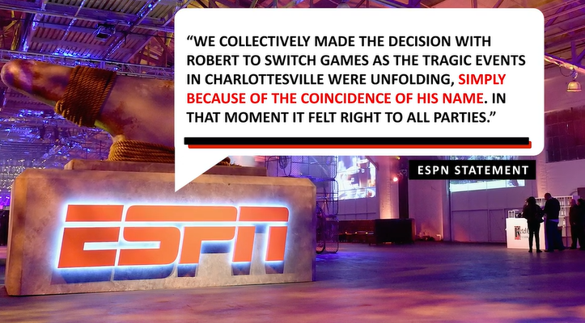
Race in America Today Hypersensitivity on the Race Issue: ESPN
ESPN decision on Robert Lee in the aftermath of Charlottesville (August 2017):
The controversy in Charlottesville centered on the removal of a Robert E. Lee statue (the Confederate general from the Civil War). At the time the events were unfolding in Charlottesville, EPSN commentator, Robert Lee, was scheduled to call a Virginia football game, but because his name was so similar to Robert E. Lee, ESPN moved him to another city to call a different game.
Notes:
The case of Robert Lee illustrates the degree of hypersensitivity our culture has on the race issue. Robert Lee is Asian and he has no family-tree connection to the Confederate general, Robert E. Lee, so there should be no reason for ESPN to make that connection in any way. Instead of fighting the absurdity of connecting Robert Lee to Robert E. Lee, ESPN acknowledged that that connection might be made by some people, and moved their commentator to a different city and a different game.

Slide 12
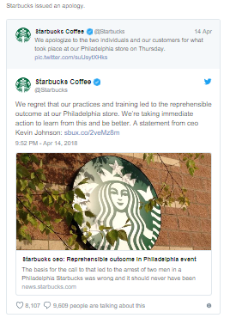
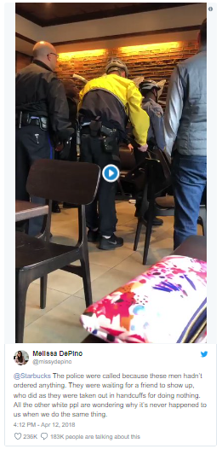
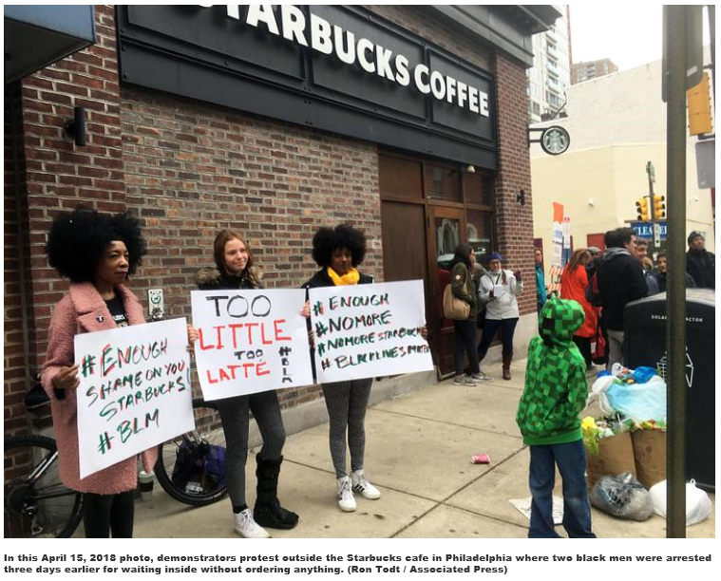
Race in America Today Starbucks Coffee’s Reaction to Racial Bias
In April 2018, two black men were kicked out of Starbuck’s, ultimately arrested. The two were waiting for a third friend to arrive
The Starbuck’s manager assumed the black men were up to no good, perhaps wanting to do drugs in the bathroom.
This incident shined a spotlight on racial bias, given that whites frequent Starbuck’s, waiting for friends, coming under no suspicion
Starbucks reacted by closing for one afternoon (May 29 2018) to provide anti-racial bias training to its employees across America
Notes:
The incident at Starbuck’s was caught on cell phone camera and immediately cause a national firestorm. You might think that perhaps this manager was an exception, just a racist who needed to be fired, but the company assumed that the bias exhibited by this one manager was systemic throughout the Starbucks chain of stores (or maybe Starbuck worried about how such a negative image could affect its brand, so it reacted as if it had a systemic problem), and so it decided to close all of its stores for one afternoon (May 29 2018) to provide its employees anti-racial bias training. This is another illustration of the hypersensitivity on the race issue. Being labeled racist, in this case in the business world, is so devastating that it requires an extreme remedy, such as shutting down all stores for an afternoon for training purposes.

Slide 13
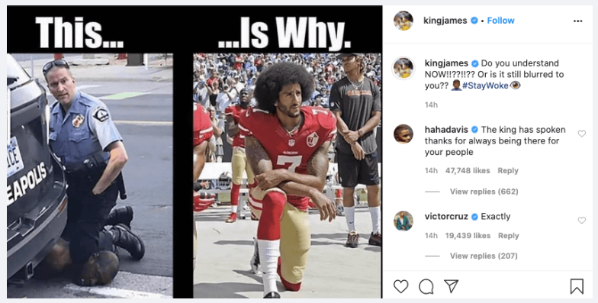
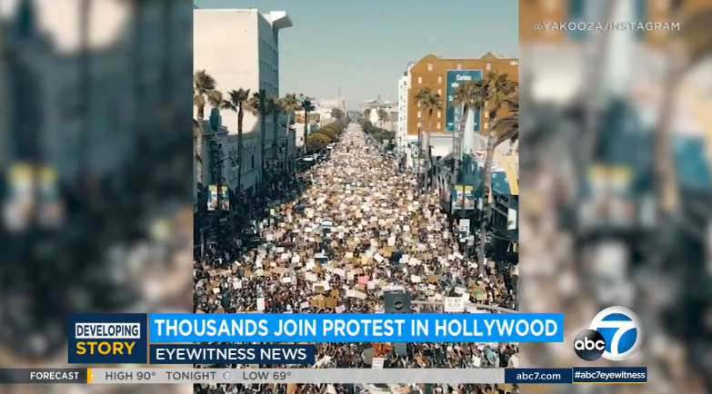
Race in America Today The George Floyd Killing
In May 2020, George Floyd was killed by Derek Chauvin, a Minneapolis police officer.
Chauvin placed his knee on Floyd’s neck for 8:46 (min:sec), even for 2+ minutes after Floyd has lost consciousness. Onlookers pleaded with the officer to remove his knee, but Chauvin refused and responded by pulling out his mace canister
Chauvin was charged with 2nd degree murder; the other 3 officers were charged with aiding and abetting
The incident sparked 3+ weeks of nationwide protests, some peaceful, some violent, as well as sweeping proposals for police reform
Notes:
https://www.nytimes.com/2020/05/31/us/george-floyd-investigation.html -- the entire video of the George Floyd killing
https://www.dailydot.com/irl/lebron-james-colin-kaepernick-george-floyd-death/ -- Lebron James’ Instagram photo, explaining why Colin Kaepernick had started a trend in the NFL of kneeling during the National Anthem.
https://abc7.com/george-floyd-protest-hollywood-yg-blm/6236686/ -- 50,000 peaceful protesters in Los Angeles on 8 June 2020, calling for police reform
The killing of George Floyd has sparked changes almost everywhere. President Trump issued an executive order on police reform (no chokeholds unless in self-defense, a nationwide database to catalogue bad cops), and Congress is considering passing nationwide standards for policing. In Texas, Governor Abbott has pledged to work with the Floyd family to pass police reform through the Texas Legislature in 2021, and the Texas Legislature passed legislation in 2021 banning chokeholds and knees-to-the-neck (i.e., banning what Derek Chauvin did to George Floyd) and requiring police officers to intervene when another officer is using excessive force (which the other officers present did not do when Derek Chauvin had his knee on George Floyd’s neck) and requiring police applicants to agree to release their conduct records from previous police departments (so that bad cops can’t just jump from one department to the next) and requiring police officers NOT to turn off their body cameras during an investigation.
The symbols of racism are coming down everywhere, even here in Texas. In Houston, a confederate statue (Dick Dowling, Confederate commander) was removed before the Juneteenth celebrations (June 19, 2020). A statue of Sul Ross has been vandalized at Texas A&M. Ross was the founder of Texas A&M, a governor of Texas, and state senator; he also served in the Confederate army. The university has formed a committee to determine the statue’s fate.
The NCAA and SEC (Southeastern Conference) have threatened not to hold any post-season football games in the State of Mississippi, if the state does not change its confederate-themed state flag, and since, the State of Mississippi changed its flag.
The coach of the Oklahoma State University (OSU) football team was forced to apologize for wearing an OAN t-shirt on a fishing trip. OAN (One America News) is a conservative news network, even more conservative than Fox News, and some of its hosts have taken issue with the Black Lives Matter movement’s goals, viewing it as a far-left organization, as well as criticizing the shutdown of the economy in response to the coronavirus. Mike Gundy (the coach of OSU) is clearly a political conservative, but some of his star players, particularly a Heisman-candidate running back, Chubba Hubbard, have protested the coach wearing such a shirt in the political environment that exists after George Floyd’s death.
Businesses have reacted to George Floyd’s death as well. Quaker Oats is going to rebrand its 130-year old “Aunt Jemima” picture on its syrup and other products. It has changed the picture of “Aunt Jemima” a few times over the decades, again so that it does not reflect such a racist image, but the company admitted after the George Floyd incident, that its past efforts were not enough, so now the “Aunt Jemima” image will be entirely changed. Dryer’s ice cream is going to rebrand its 99-year old “Eskimo Pie” products, because they are derogatory to American Indians. HBO Max temporarily suspended showing Gone With The Wind to insert historical commentary into the movie. The movie glorifies the slave South in the 1864 timeframe, and it has characters that feed racist stereotypes of blacks.

Slide 14
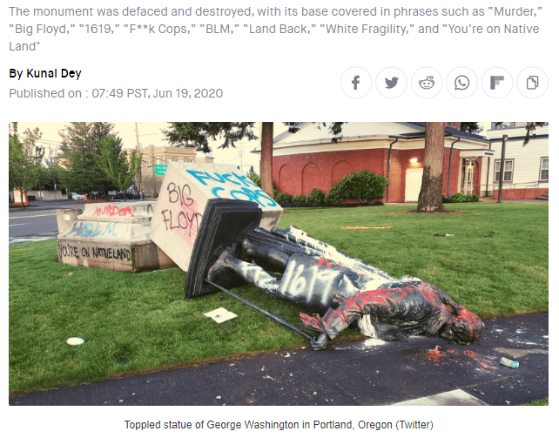
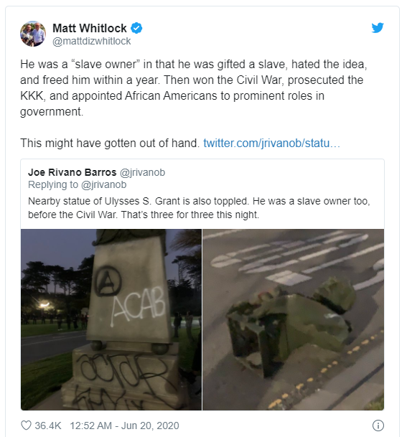
Race in America Today Post-George Floyd: Violence and Vandalism in Response to Racial Injustice
The cause of racial equality could be undermined by the violent demonstrators who have infiltrated the George Floyd protest rallies. A statue of George Washington and Ulysses S. Grant were toppled in Juneteenth rallies (June 19th 2020). Both were slave owners, but as commanding generals, Washington defeated monarchy, and Grant defeated the Confederacy
Notes:
https://meaww.com/statue-george-washington-wrapped-burning-us-flag-protest-portland-Oregon -- A George Washington statue is destroyed at a Juneteenth Rally (June 19, 2020) in Portland, Oregon.
Despite being a slave owner, George Washington freed our country from Monarchy, then as a victorious general in the Revolutionary War, Washington walked away from power. Up to that point in the world, the spoils of victory was power. Victorious generals took over government, but Washington believed in a better form of government.
Grant was “gifted” one slave then freed him shortly thereafter, and as a commanding general, he defeated the Confederacy, thus paving the path to the end of slavery. As president, Grant wiped out the KKK (in South Carolina), a newly formed organization in the 1870s, whose intent was to terrorize freed black people. The military operation in South Carolina was very unpopular, and it confirmed many people’s fears that the U.S military would eventually be used against a state (which was perceived as a step toward dictatorship). When the KKK started to terrorize blacks in Mississippi, Grant decided not to intervene (presumably because of the political backlash he received after intervening in South Carolina). Still, Grant was truly an advocate of equal rights between whites and blacks, i.e., he advocated for a bi-racial democracy. He appointed blacks (and Jews) to positions in his administration, at a time when that was unheard of (our country didn’t get serious about ridding our society of discrimination until the Civil Rights Act was passed in 1964, which was almost 100 years after Grant was president). When grant left office in 1877, after serving two terms (8 years), there was an election controversy and a compromise to settle the controversy, and that compromise was that the Southern states would allow the Northern states to have their candidate in the 1876 presidential election to be president (Rutherford B. Hayes) if the new president would withdraw federal troops from the Southern states (the Southern states were governed by military governments from 1865-1877). Once the U.S. Army withdrew in 1877, the South return to a one-race system, so what Grant did as president was to hold back the norms of racism for 8 years, but when he left office, those norms resumed. Grant was a leader of civil rights, in an era when that was not the norm (as it is today), yet his statue was destroyed in post-George Floyd protest rallies by violent demonstrators who are ignorant of our history.
Nobody is perfect. Both Washington and Grant are flawed, as we all are. “Purity” tests are the values of authoritarianism, and what we are witnessing from violent demonstrators is a form of purity test, where if you have any flaw, then you must be punished. Tolerance for unpopular ideas and beliefs are the values of a democracy, as we are witnessing today (June 2020) even among peaceful protesters of the police who are rejecting the value of tolerance, because far too few of those who sincerely want police reform and the redistribution of police budgets for other causes (i.e., defunding the police) are speaking out against the property crime and anarchy in which the violent demonstrators have engaged. (Tolerance does not mean we cannot speak out against an opposing opinion; tolerance in the “democratic” sense means that we do not engage in violence or property crime or perhaps even other forms of hostility, such as refraining from firing an employee with a differing viewpoint.)
That’s my take, but the voices of intolerance on the other side are much stronger. Here’s a synopsis of an argument by the New York Times (NYT) for taking down Mount Rushmore, which includes the faces of George Washington, Thomas Jefferson, Theodore Roosevelt, and Abraham Lincoln: https://www.dailywire.com/news/nyt-lays-out-the-case-against-mount-rushmore-critics-remind-paper-of-its-own-problematic-past?utm_source=Jeeng

Slide 15
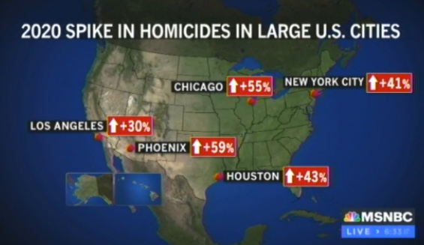
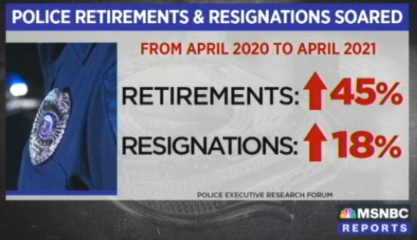
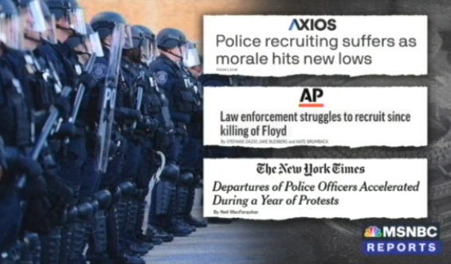
Race in America Today Post-George Floyd: Defund the Police and Its Consequences
As a solution for police brutality, “Defund the Police” became a rallying cry of the George Floyd protest rallies (Summer 2020), and cities around the country (e.g., Portland, Austin, New York City) have redirected police budgets to other social services.
The consequence: In 2021, spikes in homicide and other serious crimes + increased police resignations and retirements + record lows in police morale
Notes:
Graphic on left: Stephanie Ruhle Reports (MSNBC) 5-25-2021
Graphics on the right: Stephanie Ruhle Reports (MSNBC) 6-22-2021

Slide 16
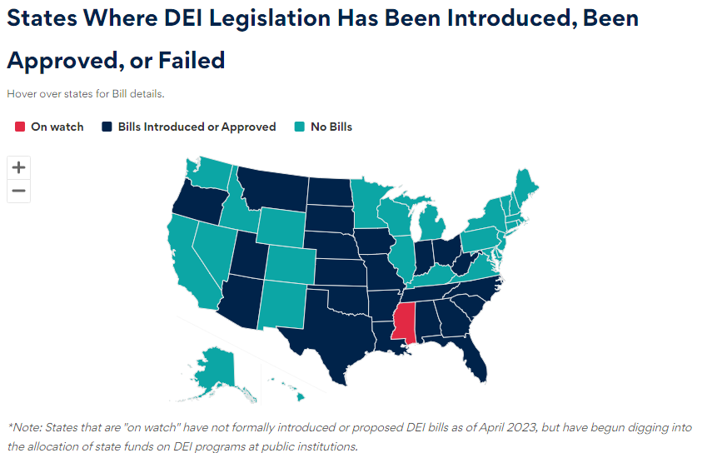
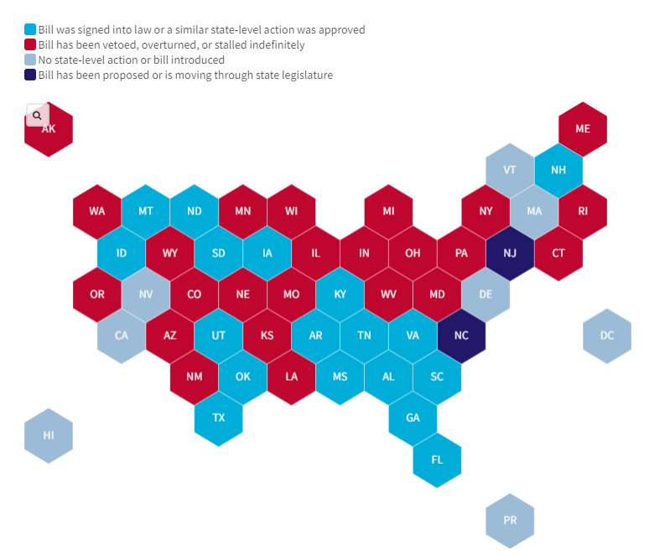
Race in America Today Post-George Floyd: Bans on DEI and CRT
Some Republican and conservative state legislatures have pushed back against the new civil rights in the post-George Floyd era, banning Diversity, Equity and Inclusion (DEI) in public institutions (such as at universities) and the teaching of race, labeled as Critical Race Theory (CRT), in K-12 schools, believing that DEI and CRT are encouraging exclusion of (DEI) and racism against (CRT) white people
DEI (Apr. 2023)
CRT (June 2023)
Notes:
Source of DEI bans: Anti-DEI Legislation Tracker | BestColleges https://www.bestcolleges.com/news/anti-dei-legislation-tracker/
Source of CRT bans: Map: Where Critical Race Theory Is Under Attack (edweek.org) https://www.edweek.org/policy-politics/map-where-critical-race-theory-is-under-attack/2021/06
States that have considered anti-CRT legislation: Teacher Anti-CRT Bills Coast To Coast: A State By State Guide (forbes.com) https://www.forbes.com/sites/petergreene/2022/02/16/teacher-anti-crt-bills-coast-to-coast-a-state-by-state-guide/?sh=1cc3ff6c4ff6. Also, see: Map: See which states have passed critical race theory bills (nbcnews.com) https://www.nbcnews.com/news/nbcblk/map-see-which-states-have-passed-critical-race-theory-bills-n1271215
States that have considered banning DEI offices at public colleges and universities: Anti-DEI bills in these red states are targeting diversity in colleges (usatoday.com) https://www.usatoday.com/story/news/education/2023/03/23/dei-diversity-in-colleges-targeted-by-conservative-red-states/11515522002/
Perhaps racism is not as bad as we think it is, according to this author: Americans Are Convinced That Race Relations Are Bad. The Data Says the Opposite | Opinion (newsweek.com) https://www.newsweek.com/americans-are-convinced-that-race-relations-are-bad-data-says-opposite-opinion-1791265
The Debate about Critical Race Theory
Critical Race Theory (CRT) posits that there is racism built into laws of our national and state governments, as well as in rules and policies of private and public institutions, such as in large corporations and universities. Identifying this type of racism would require people with skills to comb through laws and policies and analyze their consequences in society, businesses, and institutions. Such skills are usually found among attorneys. Courses in CRT are usually taught in law school, not in undergraduate studies at colleges and universities or in K – 12 schools. So, the push back against CRT is about how race is taught in the classroom, and perhaps the only common element between an elementary school classroom and a law school classroom is the theory that racism is systemic, meaning that it is so entrenched that it cannot be reversed. If true, then our democracy is incapable of eliminating racism and that white people and people of all races are not capable of ridding themselves of racism, so ultimately, another system (other than democracy) would be needed to uproot racism and start anew.
The CRT bans are usually targeted at K – 12 schools, and these bans usually prohibit teaching that one race or sex is superior to another (e.g., or that one race or sex is inherently racist (e.g., that all white people are racist) or that one race or sex deserves blame for actions committed in the past by that race or sex (e.g., whites should not be blamed for racism, segregation, and slavery because whites in the past committed these acts against blacks). Conservatives, mostly but not exclusively white, don’t want CRT to be used to promote racism against whites.
The Debate about Diversity, Equity, and Inclusion
Diversity, Equity, and Inclusion (DEI) offices were created to encourage a sense of belonging for people of color in private and public institutions, such as in large corporations and in universities. The opponents of DEI believe that it has been used to favor people of color in hiring and employment and in policies implemented in the workplace. The DEI bans prohibit these preferences. For instance, the Texas law (SB17 (2023)) prohibits, “promoting differential treatment of or providing special benefits to individuals on the basis of race, color, or ethnicity.” The Texas law also prohibits, “influencing hiring or employment practices at the institution with respect to race, sex, color, or ethnicity, other than through the use of color-blind and sex-neutral hiring processes in accordance with any applicable state and federal antidiscrimination laws.” These bans typically prohibit DEI training unless the training is to inform employees as to how to comply with the ban.
Conservatives, mostly but not exclusively white, don’t want DEI to be employed to exclude whites, i.e., not to employ the idea of “inclusion” at the “exclusion” of whites.

Slide 17
Discrimination/Racism
An International Perspective

Slide 18
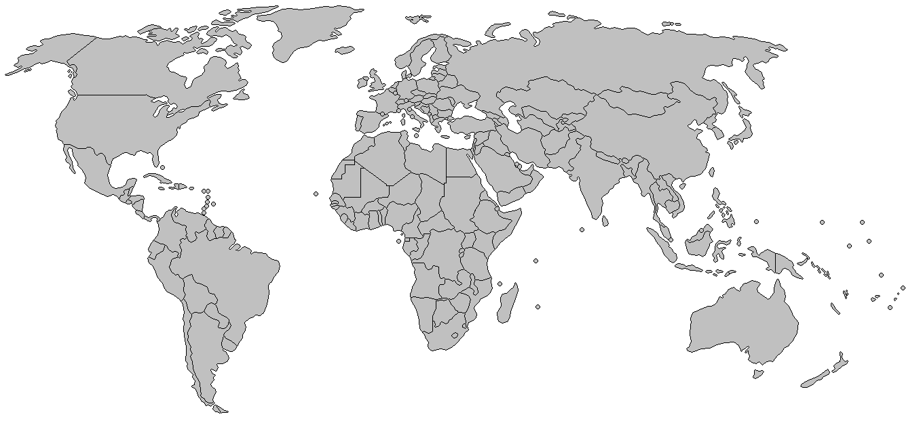
Discrimination and Racism An International Perspective
Discrimination based on race, religion, ethnicity has been a worldwide problem, even in the modern world
“Ethnic Cleansing” in The Balkans (1990s)
ISIS killings of Christians (2014-2019)
Genocide in Darfur region of Sudan (2003-2009)
Tribal Massacres in Rwanda (1994)
Apartheid in South Africa (1980s – 1990s)
Notes:
Generally speaking, minorities are treated harshly everywhere: Palestinians in Israel, ethnic Russians in Baltic states, Koreans in Japan, and in many other locations.
Violence and murder against “disfavored” groups
The Balkans (1990s) – “Ethnic cleansing” resulted in hundreds of thousands of deaths; discrimination based on ethnicity/religion
Serbian (orthodox) Christians engaged in mass killings of Muslims and Croatian Catholics…and vice versa
Rwanda (1994) – Tribal massacres resulted in 800K deaths; discrimination based upon tribal/group identification
Hutu majority engaged in mass murder of Tutsi minority, a tribal rivalry for power
Discrimination/Racism
South Africa (1980s-1990s) – White minority rule over majority black population came to an end in 1994, with election of Nelson Mandela
Apartheid was a harsh system of segregation
Darfur region of Sudan (2003 – ~2009) – Arab militias (Janjaweed), with government assistance have killed ~500K non-Arab Sudanese
Darfur: The US had secured a right to passage through Libya to move into the Darfur region of Sudan, just in case the US wanted to intervene to stop the genocide. The US pushed for action through the UN, secured a UN Security Council resolution authorizing an African Union force (only 7000 troops) and later authorization for a 20K strong UN peacekeeping force. For a while, the Sudanese government blocked the larger 20K force (the home government must approve of an outside force within its borders). The US is providing food aid to the more than one million refugees in the Darfur region. The killing is a case of racist motivated murder, Arab v. non-Arab, at least the Janjaweed perceive differences (some say there are no distinctions, that almost all people of Darfur speak Arabic (making them Arab) and all are Black (so there are not racial differences).
Discrimination against immigrants is a worldwide problem, not just in America. Hispanic leaders in America view opposition to (illegal) immigration as racism. Beliefs such as these are held by minorities in other countries also. For instance, Muslims in France engaged in violent protests (2005) against the French government because Muslim youth feel as if they are discriminated against when seeking a job.

Slide 19
Race and Politics
The Consequence of Racist Statements
Notes:
Video: Baseball announcer fired for use of N-word on air | CNN Business https://www.cnn.com/videos/media/2023/05/27/glen-kuiper-sports-announcer-oakland-as-fired-racial-slur-smerconish-vpx.cnn – In May 2023, Glen Kuiper, an announcer for the Oakland A’s MLB team, said the n-word during the pre-game segment of the broadcast. Kuiper and a colleague had visited the Negro League Baseball Museum (NLBM) in Kansas City, MO. prior to a game between the Kansas City Royals and Oakland A’s, and Kuiper mentioned that he had a great time visiting and getting a tour of the museum, but instead of using the word “negro,” he used the “n-word” slur when describing the NLBM. Kuiper was fired after being an announcer for Oakland A’s baseball game for 20 years.

Slide 20
Controversial Racial Statements The World of Sports (Commentators)
Racial statements are no longer tolerated in America
Howard Cosell (1982) – On Monday Night Football (1982), Cosell made a racial slur (“little monkey”) about a NFL wide receiver
Cosell was not a racist, called Muhammad Ali by his chosen name, while most whites insulted Ali by calling him “Cassius Clay”
Cosell used same “racial slur” to affectionately describe his grandchildren
Cosell was promptly fired from Monday Night Football
Al Campanis (1987) – On ABC Nightline (1987), Campanis said blacks may not have some of the mental faculties to be managers in Major League Baseball
Implied blacks are genetically inferior to whites
Campanis resigned from his executive position with the LA Dodgers the next day
Notes:
Howard Cosell referred to a Washington Redskin wide receiver as a “little monkey.” The receiver was small and quick by NFL standards, and Cosell said something like, “that little monkey can really run.” Hear his comments: http://www.youtube.com/watch?v=fmlFCNb9Yqo
Al Campanis played major league baseball with Jackie Robinson, the first black to break the color barrier in major league baseball. Campanis harbored some latent racist beliefs, and those slipped out on national television. That evening’s Nightline was about why there were no black managers in major league baseball. Ted Koppel, the host of Nightline, gave Campanis an opportunity to dig out of the hole he had dug for himself, but Campanis just kept digging deeper. First, Campanis said that blacks may not have some of the “qualities” necessary to be a major league manager. Then after taking a commercial break, Ted Koppel commented that he didn’t think Campanis intended to say what he had just said and he gave Campanis another chance to clarify his thoughts. Then, Campanis said, “why aren’t blacks good swimmers?” again implying that blacks don’t have the “qualities” to be good swimmers. Campanis resigned his position with the LA Dodgers the next day.

Slide 21
Controversial Racial Statements The World of Sports (Commentators)
Racial statements are no longer tolerated in America
Jimmy “The Greek” (1987) -- In an interview (1987), “The Greek” said blacks are better athletes than whites because during the days of slavery, slave masters forced big and strong slaves to have children
The statement was factually false + implied a genetic component to the success of black athletes, rather than hard work
“The Greek” was fired from CBS NFL pre-game show
Rush Limbaugh (2003) – In 2003, Limbaugh commented that many white sports writers overrated Donovan McNabb, quarterback for the Philadelphia Eagles, because McNabb is black
Limbaugh took a shot at white liberal sports writers, who often accuse conservatives of being racist for opposing affirmative action
For quarterbacks in the NFL, the color barrier was broken in 1988, when Doug Williams led the Redskins to a Super Bowl victory
Limbaugh resigned his position with ESPN
In 2009, Limbaugh wanted to buy a stake in the St. Louis Rams, but his 2003 comments created a controversy about his views on race…and he was dropped from the consortium that wanted to purchase the team
Notes:
Jimmy “the Greek” gave the odds (e.g., Dallas Cowboys are favored to beat the Washington Redskins by 7 points) on the CBS Sunday pre-game show in the 1970s.
Rush Limbaugh is a conservative radio talk show host who is an avid pro football fan. He was hired by ESPN to give commentary about football but only lasted a couple weeks on the job. Limbaugh believes white liberals are racists, and he’s angry that liberals often accuse conservatives of being racist for opposing affirmative action. He accused white liberal sports writers in the Philadelphia market of overrating Donovan McNabb because they wanted to see a black quarterback succeed, and what he implied with this accusation is that liberals only see race and not merits, which Limbaugh believes is a racist mindset. He accused the white sports writers of supporting McNabb because he is black, not because he is the best quarterback in the game. McNabb took offense to Limbaugh’s comments, believing the comments were racist at heart. The controversy forced Limbaugh to resign his position at ESPN. What happened here is that Limbaugh got over anxious to take a shot at white liberals on the race issue. He hates liberals so much that he couldn’t wait for a more opportune moment to make his case that white liberals are the real racists. To bring up race in the context of NFL quarterbacks was odd because the color barrier for NFL quarterbacks was broken 15 years earlier, when Doug Williams led the Washington Redskins to a Super Bowl victory. So, there is no reason why white liberal sports writers would need to trump up a black quarterback today, since everybody knows that a black quarterback can lead his team to a victory in the Super Bowl. It had already been done 15 years earlier.
In 2007, the first black head coach’s team won the Super Bowl. That coach was Tony Dungy of the Indianapolis Colts. Interestingly, both opposing team’s head coaches were black. Dungy did not make race an issue. In fact, he downplayed it, commenting that he had been held back in his career because of his mild manners (he doesn’t curse or scream to motivate his players), not because of race. Mike Tomlin is head coach of the Pittsburgh Steelers, which won the Super Bowl in 2009 (2008-2009 season). No one even mentioned race after Tomlin’s team won, since the race barrier for a winning black head coach had already been broken the previous year.

Slide 22
Controversial Racial Statements The World of Sports (NFL Coaches)
Racial statements are no longer tolerated in America
Jon Gruden (2021) – Gruden resigned as head coach of the Las Vegas Raiders for making offensive and racist remarks about the NFL Players Association president (DeMaurice Smith) in a 2011 email
The NFL conducted a 10-month investigation of the Washington Football Team for subjecting its female employees to a toxic work environment, which included 100s of witness interviews and 650,000 emails
To date, only Gruden’s emails were leaked to the media, allegedly, because he called the NFL commissioner a “pussy” in one of the emails
In the more controversial email, Gruden referred to Smith, a black man, as having “lips the size of Michelin tires”
In another email, Gruden made an anti-gay remark, writing that the NFL should not pressure teams to draft “queers” (in reference to Michael Sam, a linebacker drafted by the Tennessee Titans, who was openly gay)
Notes:
As head coach, Jon Gruden led the Tampa Bay Buccaneers to a Super Bowl victory in the 2002 season. Gruden later retired from coaching to become an NFL commentator on Monday Night Football. He was recruited back to coaching by the owner of the then Oakland Raiders (now the Las Vegas Raiders) in 2018. Gruden was on path to rebuilding the Raiders into a competitive team before he was ousted for racist and homophobic emails that he sent 10 years ago. The NFL is under pressure to release all of its finding from the investigation of the Washington Football Team, but to date (Oct 2021), only Gruden’s emails have been leaked to the media.
See: The Jon Gruden emails were just a small part of a much bigger investigation and the NFL is under fire to release more (yahoo.com) https://sports.yahoo.com/nfl-under-increasing-pressure-release-192137000.html

Slide 23
Controversial Racial Statements The World of Sports (NBA Owners)
Racial statements are no longer tolerated in America
Don Sterling (2014) – In 2014, the NBA forced Don Sterling to sell the LA Clippers after Sterling’s racist sentiments about black people was revealed to the public
In a private conversation with his mistress, V. Stiviano, Sterling complained to her about being seen with black people on Instagram and at LA Clipper basketball games; he was particularly perturbed by Stiviano’s association with Magic Johnson, a former NBA player and 5-time NBA champion
Bruce Levenson (2014) – In 2014, Bruce Levenson, controlling owner of the NBA’s Atlanta Hawks, voluntarily revealed to the NBA that he had made a racist remark in a 2012 email about the fan base at Hawks basketball games;
Levenson said the Hawks black fan base “scared away the whites” and that he wanted some white cheerleaders and music that would appeal to the typical 40-year old white fan
Levenson decided to sell his interest in the team, particularly after he had been such a strong critic of Don Sterling earlier in the year
Notes:
https://www.youtube.com/watch?v=y6h83OjQPok – Here Don Sterling’s racist rant with his mistress, V. Stiviano, in April 2014. This was a private conversation that Stiviano taped and then turned over to TMZ Sports, which broke the story. Sterling said that he wanted Stiviano to be viewed as a delicate Latina or white girl but felt that her association with blacks on Instagram and at LA Clipper basketball games would tarnish her image.
Atlanta Hawks
Here is Bruce Levenson’s (controlling owner of the NBA’s Atlanta Hawks) confession about a racist remark he made in a 2012 email: “I have said repeatedly that the NBA should have zero tolerance for racism, and I strongly believe that to be true. That is why I voluntarily reported my inappropriate e-mail to the NBA.” “After much long and difficult contemplation, I have decided that it is in the best interests of the team, the Atlanta community, and the NBA to sell my controlling interest in the Hawks franchise.”

Slide 24
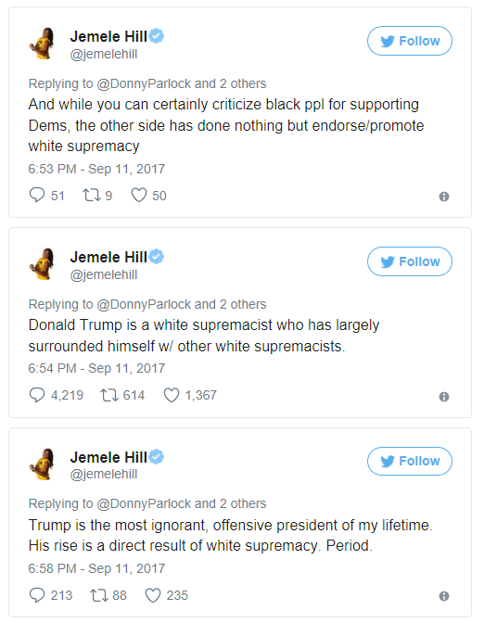
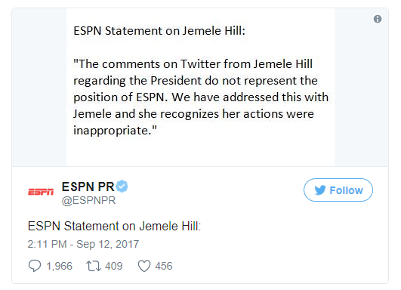
Controversial Racial Statements The World of Sports (ESPN)
ESPN did not fire Jamele Hill for calling Donald Trump a white supremacist
ESPN commentator Jamele Hill on Trump:
Jamele Hill Tweets (Sept. 2017)
ESPN Response (Sept. 2017)
Notes:
September 2017: Jamelle Hill tweeted that Trump was a “white supremacist.”
October 2017 (see: http://money.cnn.com/2017/10/22/media/jemele-hill-espn-tmz/index.html)
ESPN levied a two week suspension after Hill tweeted a response to comments made by Dallas Cowboys owner Jerry Jones, who said earlier this month that he would bench any player who "disrespects the flag." Jones was reacting to NFL players who took a knee during the national anthem to protest police violence. "If you strongly reject what Jerry Jones said, the key is his advertisers," Hill tweeted on October 8. "Don't place the burden squarely on the players."
Hill later backtracked, saying in another tweet that she was "not advocating a NFL boycott" but that "an unfair burden has been put on players" with anthem directives.
But by then, it was too late. ESPN suspended Hill on October 9 for violating the network's social media guidelines. "She previously acknowledged letting her colleagues and company down with an impulsive tweet," the network wrote in a statement. "In the aftermath, all employees were reminded of how individual tweets may reflect negatively on ESPN and that such actions would have consequences. Hence this decision."
Here is another story on Jamele’s suspension: http://www.msn.com/en-us/sports/more-sports/espn-suspends-jemele-hill-for-2-weeks-for-%e2%80%98second-violation%e2%80%99-of-company%e2%80%99s-social-media-policy/ar-AAtbMmQ?li=BBnb7Kz&ocid=iehp

Slide 25
Controversial Racial Comments Sports Monikers: The Washington Redskins
Pressure to change racially-sensitive sports names
The Washington Redskins (2013): The Webster dictionary defines “redskin” as a term that is “usually offensive” to Native Americans
Some Indian Nations have protested the “Redskin” name in the past decades, but there was concerted effort in 2013, led by the Oneida Indian Nation, to pressure the team owner, Dan Synder, to change the name
President Obama: “If I were the owner of the team and I knew that the name of my team, even if they’ve had a storied history, that was offending a sizable group of people, I’d think about changing it.”
Tom Cole (R-OK), who is a Native American: “The name is inappropriate; it’s offensive to a lot of people, certainly to me and a lot of others, millions of others.”
Some Polls
April 2013 AP Poll: 80% support keeping the Redskins team name
2004 Annenberg Institute Poll: 90% of Native Americans were not bothered by the “Washington Redskins” name
The Washington Football Team (2020) – A temporary new name
In the wake of the police killing of George Floyd, Dan Synder, team owner, decided to change the name (July 2020), when FedEx, which owns the stadium in which the team plays, threatened not to support the team. Amazon and other retailers also stopped selling “Redskin” merchandise
Notes:
In 2022, the Washington Football Team changed its name to the Washington Commanders. Relatedly, in Major League Baseball (MLB), the Cleveland Indians changed its name to Cleveland Guardians.
--------------------------------------------
Source for poll: http://www.redskins.com/news-and-events/article-1/Response-To-Pres-Obamas-Comments/840abfd8-d874-490f-966e-9a5cc305f631
Tom Cole interview: http://www.youtube.com/watch?v=nKpMg4KQmyo
In June 2014, the U.S. Patent Office withdrew trademark protection for the Washington Redskins moniker. The Patent Office panel remarked that the moniker is not worth trademark protection, presumably because it is offensive to some Native Americans. This is government action against offensive speech, which is more alarming than private sector action against offensive speech. The government is supposed to protect free speech rights, even when that speech is very offensive.
The Washington Redskins will appeal this decision to a federal court.
https://www.washingtontimes.com/news/2016/oct/3/supreme-court-rejects-redskins-trademark-appeal/ -- An Asian rock band called The Slants won their case in the Supreme Court, which ruled that canceling their trademark violates free speech. The Redskins case was not heard, but the Supreme Court’s decision will also apply to the Redskins as well.
https://www.npr.org/sections/thetwo-way/2017/06/19/533514196/the-slants-win-supreme-court-battle-over-bands-name-in-trademark-dispute – Here is an article about the US Supreme Court case regarding The Slants, and Asian rock band whose name was denied by the US Patent Office because the name was offensive to Asians.
More from the World of Sports
In Feb. 2012, two ESPN employees were punished for a headline about the remarkable early season performances of Jeremy Lin, a NY Knicks guard in the NBA (who now plays for the Houston Rockets). The headline was posted on ESPN.com for three hours before it was taken down—it read something like, Lin is the “chink in the Knick’s armor.” “Chink” is a slur against Asians. The employee responsible for the headline was fired, and a commentator was suspended for one month for reading the headline on the air.
Craig James was a star football player in high school, college and in the NFL. After his playing days, he became an ESPN announcer of college football games. In 2012, James took a hiatus to run in the Republican primary for the U.S. Senate in Texas (Ted Cruz eventually won the primary and the U.S. Senate seat). On the campaign trail, James criticized one of his competitors for attending a gay pride rally, saying that he would never endorse such a thing, and that gays would have to “answer to the Lord for their actions.” Because of the anti-gay comment, ESPN would not rehire James. The Fox Sports Network then hired James to call college games but later changed course, again being influenced by the fallout over the anti-gay comments.

Slide 26
Controversial Racial Statements Talk Radio and Cable News
Racial statements are no longer tolerated in America
Don Imus (2007) – Imus made a racist/sexist statement about the women on the Rutgers women’s basketball team, which made it to the national championship game
Imus called the girls “nappy-headed ho’s”
CBS/MSNBC fired Imus…after ~18 month hiatus, Imus landed a new show on Sirius Radio
Dr. Laura (2010) – Dr. Laura, who was a socially-conservative radio talk show host since 1993, said the “n-word” multiple times on air
Dr. Laura was trying to make a statement against double standards – that black people can use the “n-word” but white people can’t
She resigned her position as a radio talk show host in protest of interest groups (e.g., Media Matters) who called for her firing
Notes:
Don Imus
Don Imus called the women on Rutgers women’s basketball team “nappy-headed ho’s.” As it turns out, these women were good students and very talented athletes, the opposite of “ho’s”. Imus was fired from MSNBC, and he lost his radio program. See video posted on Don Imus.
Dr. Laura
Hear Dr. Laura’s comments and an interview with Dr. Laura: 1) http://www.youtube.com/watch?v=Ob6Ed69w548, 2) http://www.youtube.com/watch?v=xSeh2uoc18c&feature=related
Megan Kelly
In October 2018, NBC and Megan Kelly worked out a deal such that Kelly would leave her morning show on NBC, after Kelly had made a comment about whites wearing a “black face” as Halloween costume, that it was okay when she was growing up. The comment sparked a controversy, as to whether Kelly had made a racist or racially-sensitive comment. Here is a video on the subject: https://www.bing.com/videos/search?q=megan+kelly+black+face&view=detail&mid=84FD6A171AB43BADB21F84FD6A171AB43BADB21F&FORM=VIRE

Slide 27
Controversial Racial Statements Popular Culture: Food Network and Sit Coms and Dramas
Racial statements are no longer tolerated in America
Paula Deen (2013) – In a legal deposition in May (2013), Deen admitted to using the n-word decades ago when she was younger
In June (2013), the Food Network terminated Dean’s contract. Deen had become a food guru on the Food Network over the course of 11 years
Rosanne Barr (2018) – The reboot of the Rosanne show was hugely successful in 2018, but Rosanne is outspoken and sometimes outrageous in her comments
ABC canceled the Rosanne show after Rosanne disparagingly tweeted about Valerie Jarrett, a former advisor to President Obama
Valerie Jarrett had taken part in a program discussing racial biases in everyday life on the same day Starbuck’s shutdown its stores for racial bias training (5-29-18)
Jussie Smollett (2019) – the Empire actor was arrested for filing a false police report and for sending a fake (threatening) letter in the mail, staging a hoax racist and homophobic attack (on himself)
Smollett hired two men to attack him, claiming to be MAGA (Trump) supporters, putting a noose around his neck, dousing him in bleach, calling him the n-word and “faggot”…Smollett was hoping to aggrandize his standing in TV and movies
Notes:
Paula Deen
A former restaurant employee, Lisa Jackson (at a restaurant Deen and her brother own) sued Paula Deen. Jackson said that Deen had used the n-word recently. Deen denied that. Deen admitted to using the n-word some 30 years ago. In the same deposition (cited on the slide), Deen also admitted to considering using waiters dressed as slaves for an antebellum-themed wedding—based on an idea she got at a restaurant where "middle-aged black men...had on beautiful black jackets with a black bow tie.”
Here is Deen’s video apology: http://www.youtube.com/watch?v=jkwbyNKC9Kg
Rosanne Barr
Here is a story about the cancelation of the Rosanne Show: http://time.com/5294313/roseanne-cancelled-abc/
Here is what Rosanne tweeted about Valerie Jarrett, a former advisor to President Obama, “Muslim Brotherhood & Planet of the Apes had a baby = vj”. Historically, references to the animal kingdom have been racist tropes designed to dehumanize black people, with the goal of justifying mistreatment and discrimination.
Here is Rosanne’s response after the fallout. “I apologize to Valerie Jarrett and to all Americans,” Barr wrote. “I am truly sorry for making a bad joke about her politics and her looks. I should have known better. Forgive me-my joke was in bad taste.”
Samantha Bee
Samantha Bee is a comedian, and she called Ivanka Trump a “feckless cunt.” This was one day after the Rosanne Show was canceled, so Samantha Bee had to quickly apologize for her comments. She was not fired, however.
“I would like to sincerely apologize to Ivanka Trump and to my viewers for using an expletive on my show to describe her last night. It was inappropriate and inexcusable. I crossed a line, and I deeply regret it.”
11:16 AM - 31 May 2018
The Rolling Stones
In October 2021, the Rolling Stones announced that it would no longer sing “Brown Sugar” at its concerts. The song is about a white guy having sex with a black girl; it is also about being addicted to brown heroin, and it apparently references a slave owner and rape.

Slide 28
Controversial Racial Statements Universities and Colleges
Racial statements are no longer tolerated in America
Oklahoma University SAE Fraternity (2015) – A video was released exposing the Sigma Alpha Epsilon (SAE) for a racist song, singing that blacks would never be members of SAE
The OU president immediately expelled the two white students, who led the song during a social function, without a hearing or due process for the students
The OU president kicked out the SAE fraternity, disbanding the fraternity at OU
Essex County College Professor (2017) – A part-time professor of communications and pop culture was fired for announcing that no whites would be allowed to march in a Black Lives Matter rally on Memorial Day (2017)
On Tucker Carlson Tonight (Fox News Channel), the professor (Lisa Durden) said that whites would not be able to use their “white privilege card” to march in the rally
Notes:
The OU SAE racist song: http://abcnews.go.com/US/video/university-oklahoma-fraternity-sings-racist-chant-29512351
Here is a news story on the professor fired for Black Lives Matter denying whites from marching: http://www.msn.com/en-us/news/us/college-professor-fired-following-appearance-on-fox-news-where-she-defended-a-black-lives-matter-party/ar-BBDbiCw?li=BBmkt5R&ocid=spartandhp. The interview on Tucker Carlson Live occurred on June 6, 2017.

Slide 29
Controversial Racial Statements Police Departments
Racial statements are no longer tolerated in America
Ferguson Police Department (2015) – In the wake of the Michael Brown shooting, the U.S. DOJ investigated the Ferguson Police Dept and found systematic racial bias against the black community, including racist emails and targeting blacks for traffic fines
There were systematic 4th Amendment violations of the black community; this type of action violates our belief in “equality under the law”
6 city officials resigned within a week of the DOJ release of its report, including the Police Chief, the City Manager, a Municipal Judge (who levied penalties for late payments of traffic fines), a County Clerk (for racist emails), a Police Captain and Sergeant (for racist emails)
Notes:
Fallout from the DOJ report on the Ferguson Police: http://abcnews.go.com/US/ferguson-police-chief-resigns-week-justice-department-report/story?id=29560538

Slide 30
Controversial Racial Statements National, State, and Local Politics
Racial statements are no longer tolerated in politics
Steve King (R-IA) (2018-19) – Congressman Steve King was removed from committee assignments in the U.S. House by his own Republican Party for equating white supremacy with Western Civilization
The Democratic leadership in the House considered a formal censure of King, but stopped short after Republicans punished one of their own, instead referred King’s case to the House Ethics Committee
The Ethics Committee has censured 5 members since 1967, for misconduct and corruption but never for offensive free speech
Ralph Northam (2019) – Governor of Virginia, Ralph Northam, dressed in “blackface” or in a KKK hood 35 years earlier
In Feb 2019, Northam was facing pressure from his own Democratic Party members to resign, especially from Democratic candidates for president, but he resisted the calls to resign as governor and served out his term
It was also revealed that the Attorney General of Virginia (2019), Mark Herring, had also dressed in “blackface” at a college party in 1980
Ilhan Omar (D-MN) (2019) – Congresswoman Omar has made a number of statements considered to be “anti-Semitic” (anti-Jewish)
The Democratic leadership in Congress forced Omar to apologize for using anti-semitic tropes and drafted a statement that condemns anti-Semitic (and anti-Muslim) statements
Notes:
LA City Councilmember Nury Martinez resigns from office, two days after stepping down from leadership post | CNN https://www.cnn.com/2022/10/12/us/la-city-council-crisis-reform-expansion/index.html – In Oct. 2022, Nury Martinez resigned from the L.A. City Council. She was first elected to the LA City Council in 2013. An audiotaped conversation that took place in October 2021 was released of a conversation that Nury Martinez had with two other councilmembers, Gil Cedillo and Kevin de Leon, as well as with the president of the LA County Federation, Ron Herrera, an interest group that represents 300 labor unions. About George Gascon, the District Attorney in L.A., Nury Martinez said, “Fuck that guy. He’s with the blacks.” About a fellow councilmember, Mike Bonin, who is white and who adopted a black child, she said that “Bonin thinks he’s fucking black,” and that he is raising his child “like a little white kid.” Apparently, the kid had misbehaved on a float during a parade, leaning over the railing, which apparently prompted Ms. Martinez in the released conversation to call the kid, “su negrito,” and “parece changuito” (he’s a little monkey). Apparently, other racist comments were made about Jewish, Armenian, Native American, and gay people.
The fallout of these racist remarks even got the attention of the White House, and the controversy that ensued forced Martinez to resign on 10 October 2022. Ron Herrera also resigned his post as president of the LA County Federation. As of late October 2022, the other two members of city council have not resigned.
Here is a related article: Nury Martinez resigns from Los Angeles city council (nypost.com) https://nypost.com/2022/10/12/nury-martinez-resigns-from-los-angeles-city-council/
Here is another related article: Who leaked audio of Nury Martinez's racist remarks? And why? - Los Angeles Times (latimes.com) https://www.latimes.com/california/story/2022-10-13/la-city-council-nury-martinez-racist-who-leaked-audio
------------------------------------
Here is what Steve King said in an interview to the NY Times in November 2018: “White nationalist, white supremacist, Western civilization — how did that language become offensive? Why did I sit in classes teaching me about the merits of our history and our civilization?”
https://www.nytimes.com/2019/01/14/us/politics/steve-king-white-supremacy.html -- An article about Steve King’s (R-IA) removal from two committee assignments
https://www.nytimes.com/2019/01/15/us/politics/steve-king-offensive-quotes.html?module=inline – An article showing a timeline of statements from Steve King, including tweets and photos with right-wing leaders from other countries, whose positions are typically strongly anti-immigrant.
------------------------------------
I have video clips showing the Ralph Northam controversy in the dropbox folder. As a condition of his refusal to resign as governor, he insisted that he would do right by the black community for the remainder of his term. For instance, he was instrumental in the removal of the Robert E. Lee statue in Richmond, Virginia (in 2021). Richmond was the capitol city of the Confederacy, and it had erected a monument square to honor the confederacy, and the Robert E. Lee statue was the largest of the statues, sitting on a 120 foot pedestal, honoring former confederates.
------------------------------------
Here is a story on Rep. Omar (D-MN): https://www.vox.com/policy-and-politics/2019/3/6/18251639/ilhan-omar-israel-anti-semitism-jews
Here is Omar’s quote, the last line about allegiance to a foreign country is what has gotten her in trouble.
“In 2012, she tweeted that “Israel has hypnotized the world, may Allah awaken the people and help them see the evil doings of Israel.” The tweet implied that Israel and its supporters were secretly tricking the world into supporting it, a longtime anti-Semitic trope for which Omar apologized after taking office in January.”
“I heard from Jewish orgs. that my use of the word ‘hypnotize’ and the ugly sentiment it holds was offensive,” she tweeted. “I spent ... little energy [in] disavowing the anti-Semitic trope I unknowingly used, which is unfortunate and offensive.”
In mid-February, Omar created another stir when she tweeted that support for Israel in the US Congress was “all about the Benjamins,” suggesting that the pro-Israel lobby AIPAC was buying off American politicians. This smacked of the well-worn conspiracy theory that Jewish financiers buy off American politicians, and led to the Democratic leadership publicly condemning Omar’s comments.”
Omar deleted the original tweet and said she “unequivocally” apologized.
“What I’m fearful of — because Rashida [Tlaib] and I are Muslim — that a lot of our Jewish colleagues, a lot of our constituents, a lot of our allies, go to thinking that everything we say about Israel to be anti-Semitic because we are Muslim. And so to me, it’s something that becomes designed to end the debate because you get in this space of — yes, I know what intolerance looks like and I’m sensitive when someone says, “The words you used, Ilhan, are resemblance [sic] of intolerance.” And I am cautious of that and I feel pained by that.”
“But it’s almost as if, every single time we say something regardless of what it is we say that is supposed to be about foreign policy or engagement or advocacy about ending oppression or the freeing of every human life and wanting dignity, we get to be labeled something, and that ends the discussion. Because we end up defending that and nobody ever gets to have the broader debate of what is happening with Palestine. So for me, I want to talk about the political influence in this country that says it is okay for people to push for allegiance to a foreign country.”

Slide 31
Controversial Racial Statements National-Level Politics
Racial statements are no longer tolerated in politics
Geraldine Ferraro (2008) – Ferraro was the Democratic Vice Presidential candidate in 1984 and was a Hillary Clinton supporter
Ferraro commented that people are voting for Barak Obama because they are enamored with the concept of voting for a “black man for president”
Ferraro was labeled a racist and forced to resign her position with the Clinton campaign
Reverend Jeremiah Wright (2008) – Wright was Barack Obama’s pastor of 20 years; he made anti-white and anti-American comments
Obama was forced to make a major speech about race, demonstrating that he understands the grievances whites and blacks levy against each other
Notes:
About US foreign policy, Reverend Jeremiah Wright has said that America is the number one killer in the world, that the US has supported terrorism against Palestinians and black South Africans, and because of these policies, the chickens came home to roost on 9/11, essentially meaning that America deserved the terrorist attack on the World Trade Center and Pentagon. About the US government, Wright has said that the US government created the AIDS virus to commit genocide against people of color and that America is run by rich white people; Wright has referred to America as the US-KKK-of A. About Hillary Clinton, Wright has said that she has never been called the “n-word” and that she has never been doubted by her own people for not being “white enough,” which presumably is a reference to those in the black community who once questioned if Obama was “black enough.” Because the US builds prisons and passes 3-strikes-and-you-are-out laws, Wright has said that “God Bless America” should be changed to “God Damn America.”
Geraldine Ferraro is a Democrat who was forced out of her position as fundraiser for Hillary Clinton’s presidential campaign (2008) for a comment she made about Obama. Ferraro was the Democratic Vice Presidential candidate in 1984; that’s her claim to fame, and in 2008, she was a Hillary Clinton supporter; during the Democratic primaries, she commented that people were voting for Barack Obama because they were enamored with the concept of voting for a “black man for president.” This comment became very controversial and she was forced to resign as a campaign fundraiser for Hillary Clinton. Ferraro’s history of supporting civil rights, welfare and affirmative action did not save her. In a strange way, Hillary Clinton was treated like a Republican while running for president against Barack Obama in the Democratic primaries, and as a consequence, Geraldine Ferraro was treated like a Republican (and considered a racist).
In 2018, Megan Kelly lost her position with NBC because she commented that “blackface” was no big deal as a Halloween costume. Kelly came from Fox News and is a conservative, so it seemed inevitable that she would not work out on a more liberal network like NBC, where she hosted a feel-good morning show (in contrast to the hard-hitting ideologically-charged show she hosted for Fox News)
----------------------------------------------------------------
Here is a high profile example from the music business. Public Enemy was a very popular musical group in the early 1990s. The group got in trouble when one of its members made what was construed as an anti-semetic remark about Jewish control of the music recording business. After making the comment, recording executives essentially ran Public Enemy out of the music business. Chuck D made the alleged anti-semetic comment. Flavor Flav made a comeback years later; he hosted a show on cable: The Flavor of Love
Mel Gibson, movie maker and movie star, has also run into trouble for making anti-semetic remarks. I’m not sure how this has affected Gibson’s movie career.
The Jena 6 controversy elevated the issue of racial symbols. In this case, the symbol is the noose. Some 5,000 people were lynched in this country between 1865 – 1965, most of whom were black. White culture tolerated lynching during that period. In Jena, Louisiana, 3 white high schools students hung nooses from a tree to send a message to black students that they weren’t welcome to hang out under the tree. Federal law considers hanging a noose to be a “hate crime,” but federal prosecutors did not pursue a case against the white students because they had no history of violence or white supremacist ideological attachments. The question today is should people be punished for hanging a noose or should it be considered a prank, since lynching doesn’t occur today (or when does it occur, it is punished today).

Slide 32
The Obama Presidency
Race Controversies in the Obama Presidency

Slide 33
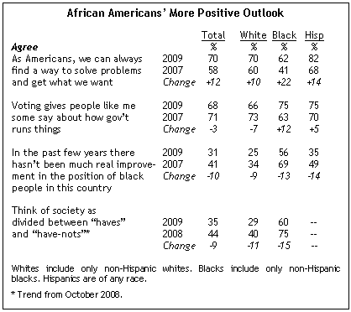
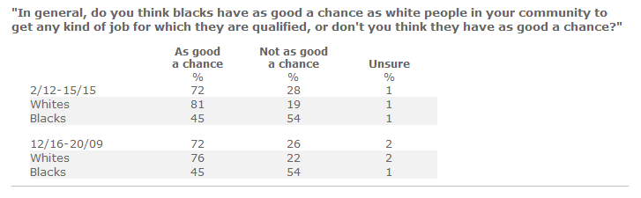
Race and Empowerment Do black people feel empowered to succeed in America?
After Obama’s election, 75% of Black Americans felt more empowered about voting, versus 63% during Bush’s administration
After Obama’s election, 60% of black people felt the “system” (haves v. have nots) is rigged against them, which is better than the 75% who felt this way during the Bush years, but 60% still indicates most blacks don’t feel empowered enough to succeed
54% of blacks don’t believe that they have an equal shot at landing a job they are qualified to have. This is another indicator that blacks do not feel empowered enough to succeed
Notes:
The bottom graphic is a 2015 poll from pollingreport.com, see http://pollingreport.com/race.htm
In political science, we often see 67% as a threshold. For instance, when 67% of a country believe in a democratic system of government, that country never turns back to a dictatorship of some kind. As for racial empowerment, I’m not certain what the magic % would be, but it is probably something close to 2/3rds (67%). So, when 45% of blacks respond in a poll that they have an equal chance of landing a job, that tells me that the % is well below the threshold for “making it” in America.
We will know our race problems in America are a thing of the past when a high enough % of blacks feel empowered enough to make it in America. At that point, the n-word won’t be such an insult to blacks (when whites say it), and whites will no longer feel so guilty about the past. It’s easy to put the past behind us when the past is no longer relevant to our lives, but racial discrimination is still relevant, in our history and in the present, so we just can’t put it behind us yet.

Slide 34
The Obama Presidency Race Controversies
The “race” labeling war in the Obama Presidency
The Beer Summit (July 2009) – Obama commented on the history of racial profiling after a white police officer arrested a black professor in Cambridge, MA. (close to Harvard University)
This implied that the white officer may have had racist motives in arresting the black professor (though Obama explicitly noted that his comments about racial profiling were unrelated to this case)
Glenn Beck, a conservative talk show host, called Obama a racist for his profiling comments – the charge did not stick and Beck apologized
Obama had a beer with the white officer and the black professor to mediate their differences, and the (potential) scandal disappeared
Notes:
Background on the Beer Summit
A white police officer’s arrest of a black Harvard professor in Cambridge, Massachusetts became a national controversy when Obama was asked a question about the arrest on July 22nd, in a news conference where Obama spoke mostly about health care. In his response to the question, Obama gave the facts of the case as he knew them at the time—Professor Gates (the black Harvard professor) locked his keys inside his house and jimmied the back door open to get inside; a neighbor saw Gates and another man trying to get into the house but did not recognize either as the owner and subsequently called the police to report a potential burglary; Officer Crowley (the white police officer) arrived at the scene to investigate and arrested Gates for disorderly conduct (a charge that was dropped later). Obama then told reporters at the news conference that the police had acted “stupidly” for arresting a man in his own home and then reminded them about the history of police profiling of blacks and Hispanics in this country. Obama pointed out that a disproportionate number of blacks and Hispanics are stopped by police, suggesting that this is evidence of racism in our society.
At the news conference, the president tried to separate his reference to police profiling from the arrest in this particular case, but within a day or two, the media was jumping all over Obama for condemning the police and for siding with Professor Gates (who Obama acknowledged as a personal friend) without knowing all the facts of the case, and the conservative media began to charge Obama as a racist for even the mention of police profiling, further suggesting that Obama is guilty of falsely accusing a white police officer of profiling.
This takes us to the “Beer Summit,” at which the president and vice president met with Officer Crowley and Professor Gates for a beer at the White House on Thursday (July 30th). Coming out of the meeting, Officer Crowley and Professor Gates agreed to meet again to reconcile their differences over the arrest (this time without Obama as a mediator). The officer believes he was doing his job by arresting the professor, but Professor Gates is still suspicious race was a motivating factor in the arrest.
The “Beer Summit” was not really about the arresting officer and the professor; it was more about Obama putting this controversy to rest. In the past, it has been powerful whites who have been harmed (i.e., forced to resign or politically damaged in some other way) for racial comments, but now that Obama is president and a prime target of his opposition, he too could be damaged politically for making a comment that could potentially be construed as racist. The last thing Obama wants is for his political opposition to levy the charge of racism against him—and have the charge stick. This could hurt Obama’s standing with white America, 43% of which voted for him in 2008. The president has not apologized for his response about the arrest (nor has the arresting officer or the professor apologized for their respective actions), but he did say that he could have phrased his words differently, probably referring to the “stupidly” remark.
Congressional Black Caucus
Back in 2011, Obama was criticized by the Congressional Black Caucus (CBC) for not doing enough for black people who were suffering worse than most because of the sluggish economy. In his first term, Obama really couldn’t do anything specifically to help blacks, because had he, he could have been accused of showing favoritism toward blacks, which could have potentially hurt him with white voters in his reelection bid in 2012. The leaders of the CBC understood Obama’s predicament at that time, but they pressured the president nevertheless. Obama was very perturbed by this, and in a speech to the CBC in Sept. 2011, Obama told the caucus to “stop complaining.” It was a rare display of emotion for President Obama, who is usually very calm and collected.
See: https://www.youtube.com/watch?v=jnop9vwnnUY

Slide 35
The Obama Presidency Race Controversies
The “race” labeling war in the Obama Presidency
Conservative Bloggers v. NAACP (2010) – White conservatives and the leadership of the NAACP consider each other to be the “real” racists in America
The Shirley Sherrod Controversy – In July 2010, conservative blogger, Andrew Breitbart (BigGovernment.com), posted a video of Shirley Sherrod speaking at an NAACP conference appearing to have discriminated against a white farmer in a previous position she had held
The conservative media picked up on the story, expressing outrage that the NAACP tolerated black racism against whites – and – Ms. Sherrod was immediately fired by Obama’s Sec. of Agriculture
A day later, the NAACP posted the full video of Ms. Sherrod’s comments, in which it became clear that she had helped the white farmer in her previous position – it was a story of her journey in overcoming bias and treating people fairly, regardless of race
The Tea Party Movement – The NAACP has since demanded that the leaders of the Tea Party movement enforce against (white) racists at its rallies, who they allege oppose Obama because the president is black
Notes:
Ms. Sherrod was offered another position in the Agriculture Department after it was realized that she was not a racist. She denied the offer to seek other opportunities, now that there was so much sympathy for her. She was the victim of a video tape that was edited in a biased way.
Had the Obama administration waited one more day before pushing Ms. Sherrod out of her position at the Agriculture Department, then they would have learned that she was innocent of the allegations of racism levied against her. So, why didn’t the Obama administration wait one more day to investigate the initial allegations against Ms. Sherrod? A potential race scandal is so politically dangerous in American politics that a president cannot wait 24 hours before taking action against an alleged racist. Obama could not wait because had he done so and had the allegations against Ms. Sherrod turned out to be true (which they weren’t), he would have appeared to have defended a racist and that would have made plausible the allegations that he is a racist. Dropping Sherrod like “a hot potato” was the right thing to do, politically, but it was not the right thing to do morally. Morally, the Obama Administration should have investigated the allegations first, then after learning that Ms. Sherrod was not a racist, they should have defended her against her attackers, but given the politics of race, that didn’t happen because they couldn’t wait to address the issue.
The Tea-Party Movement (2009-10)
Obama supporters accuse the tea-party protesters of having racist motivations against the president (because the president is black). Obama opponents (like Glen Beck and Sarah Palin) assert that the tea-partiers are against big government (socialist-oriented policies).

Slide 36
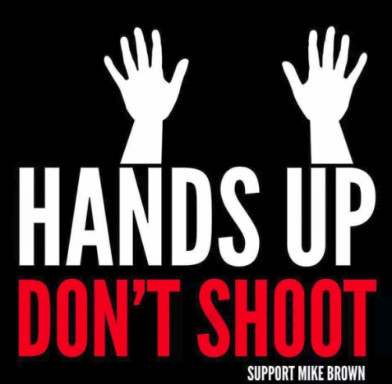
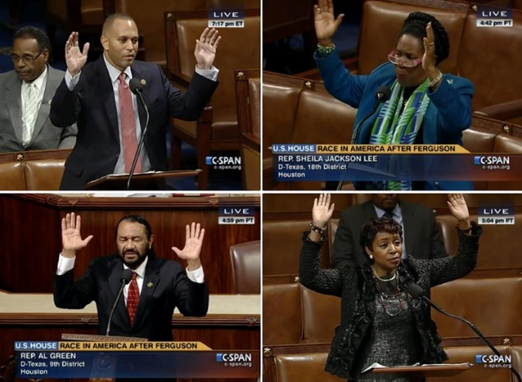
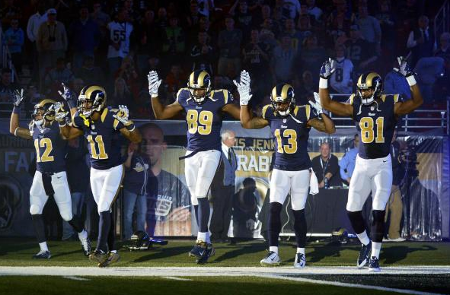
The Obama Presidency U.S. Justice Dept. Investigation of Michael Brown Shooting
After a Ferguson, Mo. grand jury decided not to indict Officer Wilson, the U.S. Justice Department investigated the shooting
The Justice Dept. concluded Officer Wilson’s story of events was correct, that Michael Brown struggled for the officer’s gun in the car, and then outside the car, charged the officer before being fatally shot
Notes:
The U.S. Justice Department investigation of the Michael Brown shooting (March 2015): http://www.justice.gov/sites/default/files/opa/press-releases/attachments/2015/03/04/doj_report_on_shooting_of_michael_brown_1.pdf
According to the U.S. Justice Dept. report, the “hands-up, don’t shoot” narrative did not happen. The Justice Department found the testimony of the three black witnesses who corroborated Officer Wilson’s story more credible than the witnesses who testified that Michael Brown tried to surrender.
The U.S. Justice Department investigation of the Ferguson Police Department (Mar. 2015): http://www.justice.gov/sites/default/files/opa/press-releases/attachments/2015/03/04/ferguson_police_department_report.pdf

Slide 37
Your Professor’s Conclusions
Our culture’s hypersensitivity to race adversely affects our freedom/rights. Free speech rights are most important in the defense of the indefensible, such as burning an American flag, preaching anti-Americanism or supporting anti-American leaders (e.g., Fidel Castro or Hugo Chavez (both now deceased)), or even expressing racist sentiments
Pushing Back against American Culture: We should punish racism with free speech, i.e., speaking out against it when it occurs or boycotting a racist business, but it is wrong for the government to punish racist speech, as in the case of the Patent Office and the Washington Redskins moniker, and it is wrong to materially punish people who engage in offensive speech, even when it is the private sector doing so, because it intimidates people into silence and subjugates the 1st Amendment to that value (of silencing offensive speech)
Notes:
Your professor’s commentary: We should enforce equality under the law. Systemic racism in a police department is wrong and that culture needs to change. Systemic racism embraces “inequality” under the law. My commentary on the slide is focused on speech, not on police brutality and killing. When a black man is killed by the police, and if it is an unjustified homicide, then that officer should be punished to the full extent of the law. What I am so alarmed about is our culture’s abandonment of the 1st Amendment, that anything “offensive” must be punished. That results in silencing people who have an alternative position, and that is dangerous to the survival of a democracy.
On Firing People
In the case of the Ferguson Police Department (Ferguson is the city in which Michael Brown was shot), the resignations and firings were good. The people who resigned or who were fired represented local government (the police are part of local government), and when the government violates the rights and freedoms of black Americans, that needs to be exposed to the public and the violators need to be rooted out of government.
In most if not all of the other cases, I (your professor) believe it was wrong to fire or force to resign people who made racist statements because our highest value becomes “silencing offensive speech” rather than protecting “offensive speech,” as the 1st Amendment demands.
In the case of the University of Oklahoma, the two racist fraternity members probably would have been expelled from the university, had they been given their due process rights of adjudicating their case (in accordance with the rules of the university). What was wrong in that case was that they were denied their due process rights (again, under the rules of the university); the students had a right to defend themselves, and that right was denied.
-------------------------
When Rayshard Brooks was killed by a police officer in Atlanta Georgia (June 2020), the step-mother of the offending officer (Melissa Rolfe) was fired from her job. The step-mother had nothing to do with the killing, yet she was fired. This is blood guilt, again a value practiced by authoritarians (North Korea punishes 3 generations of family members when one family member is apprehended for doing something wrong). Apparently, Melissa Rolfe posted something on social media that caused some divisions in the office, which was the “stated reason” for firing her, but most likely, the “real reason” was that her employer did not want to be connected to her stepson in any way. I don’t know what Ms. Wolfe posted, but my guess is that it was some sort of defense of her stepson, who had been charged with murder, potentially carrying the death penalty. A stepmother cannot even defend her stepson without being fired. This is yet another example of our culture increasingly embracing the value of silencing “unpopular” speech, a value that runs counter to the values that underlie a democracy. (https://www.dailymail.co.uk/news/article-8440383/Stepmom-Atlanta-cop-charged-Rayshard-Brooks-death-fired-job.html).
https://www.cnn.com/2022/08/23/us/rayshard-brooks-atlanta-police-charges/index.html – Murder charges were dropped against Garrett Rolfe two years later. It was found that he was in his right to shoot Rayshard Brooks who shot a taser at the officer.

